Slide 1


Engaging Members
RLI - Part 1
Notes:
Begin the session:
Introduce self
Describe format for the session
Describe use of CHAT, Hand Raising, Breakouts, Annotation Tools, and use of Webcam

Slide 2
Goals:
Discuss
Recognize the value of engaging members
Develop
Explore options for engaging members
Recognize
Discuss ways Rotarians can be involved in club activities
Reflect
Reflect on ways in which clubs can engage members
Notes:
Review Session Goals, where this course fits into the Membership curriculum of RLI
Quickly review Insert: EM-1 “Good to Know for Engaging Members” and EM-3
Show where to find referenced materials https://my.rotary.org/en/document/improving-your-member-retention-retention-assessment-and-analysis
PDFs
Connect for Good; Improving Retention; Understanding Why Members Leave; Enhancing Club Experience
Point out that participant manual contains some resources that are not directly used in this session but provide resources for participants.

Slide 3

Are Rotary clubs MEMBER organizations that do Service or SERVICE organizations that have members?
Notes:
Ask the question posed on the slide.
Show participants how to add notes using Annotation Tools

Slide 4
Is Rotary a Member or Service Organization?
Member
Service
Notes:
Direct participants to add their responses to the blank slide
View responses and comment on them.
Discuss Member vs. Service organizations

Slide 5
Breakouts
Why are you in YOUR Rotary Club?
What keeps you in Rotary?
Notes:
1. That brings us to:
Why did you join YOUR Rotary Club?
What keeps you in Rotary?
2. Divide group into partners or trios.
3. Direct participants to talk with their partner(s) about these
two questions.
4. Let them know they will have 3 minutes
In order to share this slide to breakout rooms, you don’t need to stop sharing. Just hit the Share button again, and maker sure you click the option to “Share to Breakouts” along the right side of the screen. This option is not available until AFTER breakouts are started.
You may also “Broadcast” your voice to breakouts if you wish to give them more specific instructions, such as letting them know who is in each breakout. If you draw or mark anything on YOUR screen using Annotation Tools, they will also see that in the breakouts.
Note: If the person sharing (normally the Facilitator) joins a breakout, screen sharing will stop. For this reason, it may make sense to use a second computer to visit participants in breakouts, or to have the Producer share this slide to breakouts.
5. Ask for two or three volunteers to share their thoughts
6. Give them a couple minutes to share

Slide 6
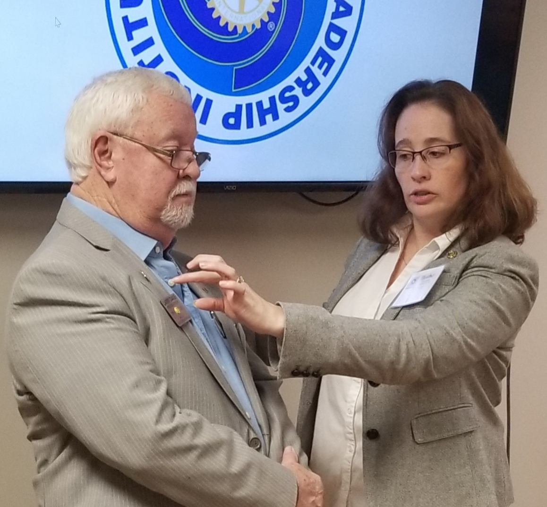
Describe your Induction
Notes:
Ask participants to describe their induction:
When you were inducted into Rotary, was it a special event or an afterthought? Tell us about it.
2. Take some examples from the group
Remind the group that making the induction of Rotarians into a Rotary club a special event is important. It says something about how much club members value new members.

Slide 7

Tell us a story…
….…about when you truly became a ROTARIAN!
(as opposed to a member of Rotary)
Notes:
We’ve talked about why we join Rotary, why we join a specific club. Now let’s consider why we stay in Rotary? More specifically when did you really become a ROTARIAN?
Take one or two stories
Point out that doing this with home clubs may be very illuminating and even reignite the passion in some as to when they truly became a Rotarian and why they continue to be a Rotarian.

Slide 8


Keys to RETENTION…
Rotarians stay in Rotary so they can:
Serve the community
Network
Represent their vocation
Develop leadership skills
Notes:
Review what we know about retention in Rotary. Share what the research says:
It has been found that ‘newer’ Rotarians (<3 years) stay in Rotary to:
a. Serve their community
b. Network
c. Represent their vocation
d. Develop leadership skills

Slide 9
Strategies
Value
Club Meetings
Fellowship
Service
Personal Growth
What can your club do to engage members?
Does your club deliver value? HOW?
Notes:
Now lead a discussion on engagement by asking the following questions:
What can you do to ENGAGE members and increase retention?
Does your club deliver VALUE?
2. Invite three or four responses from the group.

Slide 10

EM-3 Engagement Ideas
Do one of these ideas look like it might work for your club?
Notes:
Direct group to page 19 of Participant Manual and ask them to review ideas presented.
Pose the question on the slide
Do one of these ideas look like it might work for your club?
Are there other ideas you use in your club that you find successful?
Unmute yourself and/or raise your virtual hand to offer suggestions.

Slide 11
What best describes your club?
Strong
High Impact
Older
Struggling
Fun
BREAKOUTS
Notes:
Most clubs can be described as one of the five “types” on the slide.
Ask participants to think about how they would describe their club.
Explain breakout activity as follows:
Talk about what challenges such a club might face
Each breakout will be assigned a ‘club type’
Offer possible solutions to the challenge
Choose a spokesperson and recorder
You will have 6 minutes
Host will make Club Type PDF Breakout Guide available to participants by accessing from Documents for Class of My Event.
Launch breakout
Reconvene whole group after 8 minutes
Invite spokespersons to share their group solutions
Note: For small groups consider one of the following options:
Choose one (or two) club type which best describes the club types represented in the room and proceed through the activity. If only one club type, ask one individual to summarize a challenge and pass it to another person (virtually) for a possible solution.
Use group discussion format

Slide 12
Breakout Activity
  Talk about what challenges such a club might face
  Each breakout will be assigned a ‘club type’
  Offer possible solutions to the challenge
  Choose a spokesperson and recorder
  You will have 6 minutes
Strong
High Impact
Older
Struggling
Fun
Notes:
In order to share this slide to breakout rooms, you don’t need to stop sharing. Just hit the Share button again, and maker sure you click the option to “Share to Breakouts” along the right side of the screen. This option is not available until AFTER breakouts are started.
You may also “Broadcast” your voice to breakouts if you wish to give them more specific instructions, such as letting them know who is in each breakout. If you draw or mark anything on YOUR screen using Annotation Tools, they will also see that in the breakouts.
Note: If the person sharing (normally the Facilitator) joins a breakout, screen sharing will stop. For this reason, it may make sense to use a second computer to visit participants in breakouts, or to have the Producer share this slide to breakouts.

Slide 13
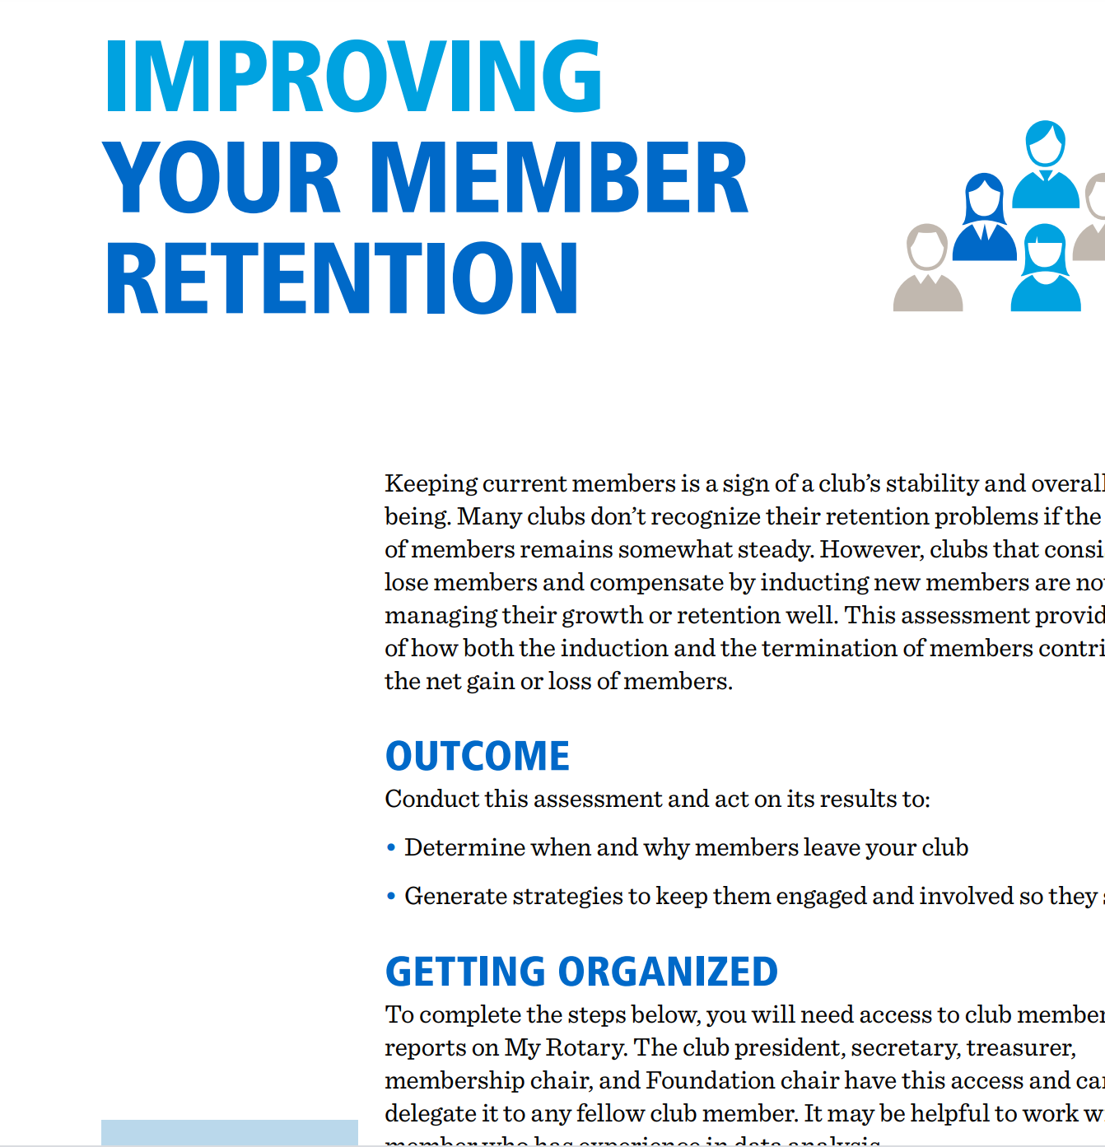
Rotary Resources
Member Satisfaction Survey – EM-2
Improving Member Retention - 801D_retention_assessment_en.pdf
Notes:
Share Rotary resources on member retention with the group
Summarize by saying:
Sometimes it can be difficult to know if your club members are engaged. Rotary provides many kinds of resources to help figure out how your members feel about what is going on in the club.
Direct the group to Insert EM-3: Membership Satisfaction survey (page 15-18 Participant Manual).
We will not take the time to fill it out now however it would be beneficial for you to take this back to your home club and administer it with club members. You can gain great insights into ways to pinpoint issues and discover possible solutions.
Additional resources are available at www.rotary.org.
Improving Member Retention ; Enhancing Your Club Experience

Slide 14

Reflection
Given our discussion, what suggestions do you want to take back to your club?
Notes:
Considering the discussions in which participants engaged during the session, pose the following question for their reflection.
Given our discussions today and any insights you may have gained, what practical suggestion(s) do you want to take back to your club?
Give them a minute to think about it and make a note of their thoughts in the participant book
If time allows, ask for one or two volunteers to share their thoughts

